Slide 1


KIET Group of Institutions, Ghaziabad
(An ISO – 9001: 2008 Certified & ‘A+’ Grade accredited Institution by NAAC)
Project Presentation (KCS 753)
E-COMMERCE FOR BAKERS
Team Members
Rahul Kumar Gautam
Guide
Prof. Anmol Jain
Mohd Danish Khan
Navneet Kumar Rao
Mohd Mohsin Ansari

Slide 2
PROBLEM STATEMENT
Limited online presence: Many bakers lack the tools and resources to effectively showcase
their products online, reducing their potential to reach a broader audience.
High costs and complexity: Current e-commerce solutions can be too complex or
expensive for small-scale bakers, limiting their ability to scale their business.
Absence of Specialized E-commerce Platforms: Most e-commerce platforms are designed
for general retail businesses and do not cater specifically to the unique needs of bakers

Slide 3
OBJECTIVE
Simplify Order Management: Provide a user-friendly platform that allows bakers to manage
custom and bulk orders efficiently.
Enhance Online Presence: Enable bakers to create a personalized online storefront to showcase
their products and services.
Increase Accessibility for Freelancers: Offer an affordable, easy-to-use platform specifically
tailored for small scale and freelance bakers.
Support Business Growth: Integrate marketing tools like social media promotion, SEO optimization
and customer review features to help bakers expand their reach.

Slide 4
TECH STACK
MongoDB (Database): Used for storing and managing product data, customer information,
and order details in a flexible, scalable NoSQL database.
Express.js (Backend Framework): Provides a robust, lightweight server-side framework
for handling API requests, routing, and connecting the frontend with the database.
React.js (Frontend Framework): Powers the dynamic and interactive user interface, enabling
smooth user experiences for browsing, customizing orders, and placing purchases.
Node.js (Runtime Environment): Used to build a fast, scalable backend that handles multiple
client requests efficiently, ensuring smooth order processing and real-time updates.

Slide 5
Sdg Mapping
SDG 8: Decent Work and Economic Growth
Justification: Your platform promotes entrepreneurship by enabling small/home bakers to reach a broader customer base, thus generating income and employment.
SDG 5: Gender Equality
Justification: Many home bakers are women. The project empowers them financially by offering equal access to e-commerce tools and market exposure.
SDG 9: Industry, Innovation, and Infrastructure
Justification: The project introduces digital infrastructure to a traditional sector, encouraging innovation and tech adoption among local food producers.

Slide 6
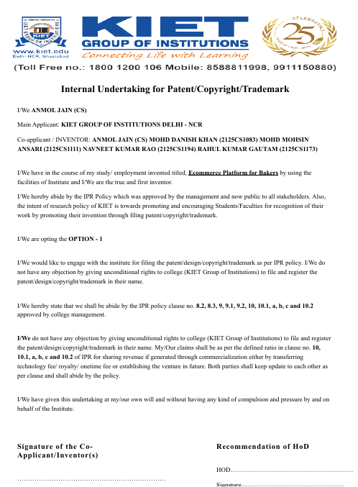

Slide 7
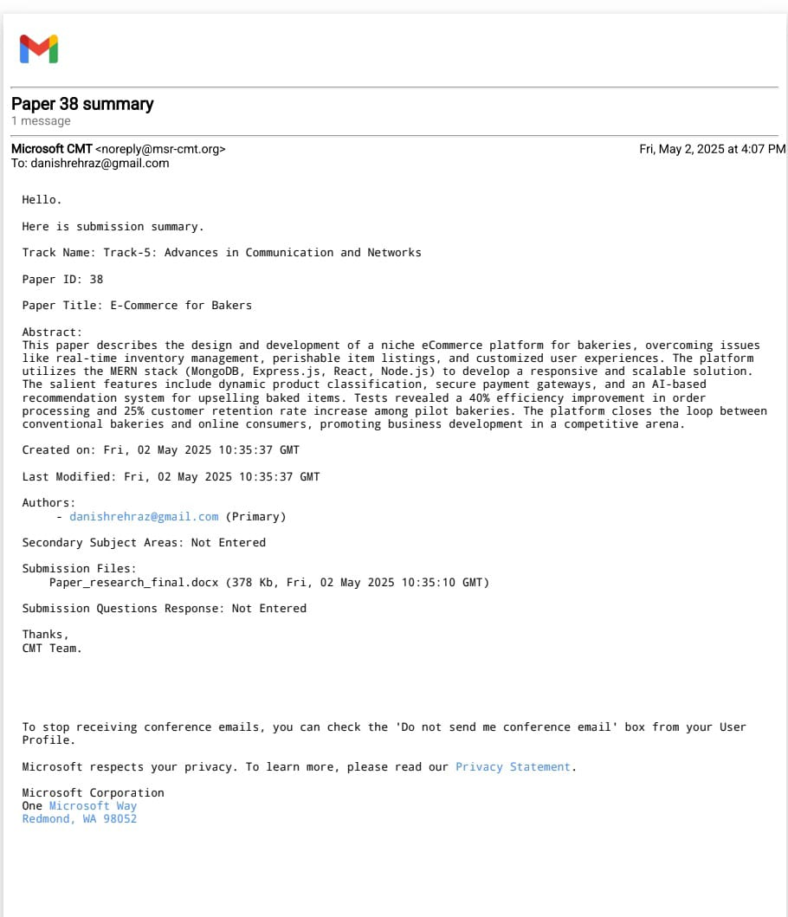

Slide 8
Thank you

